Slide 1


COMPUTER PRODUCT SUGGESTION

Slide 2
Group 13 - Team Members
Supervisor: Mr. Kiều Trọng Khánh
Phạm Hồng Sang
Huỳnh Thanh Việt
Trần Tân Lên
Hà Chí Danh (Dropped out)

Slide 3
Outline
Scenario problem
Our Solution
Demonstration
Advantages and Disadvantages of current solution
Future Plan
Questions and Answers

Slide 4
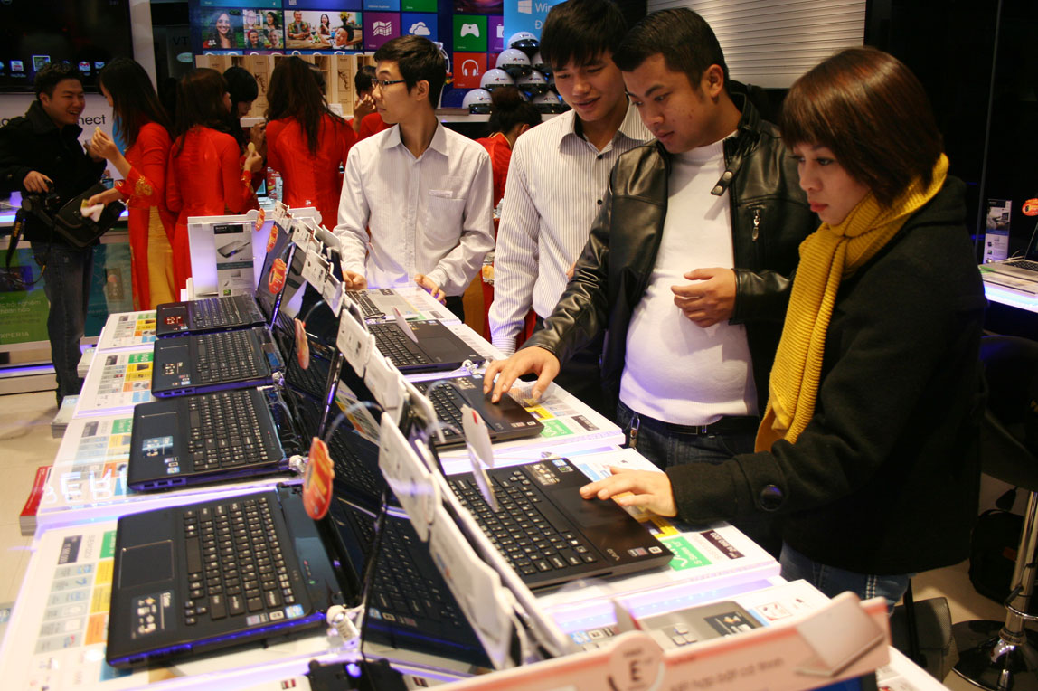
Scenario problem
!!!...
???...

Slide 5
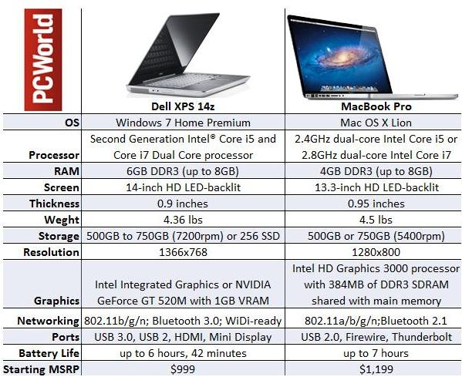
Scenario problem

Slide 6
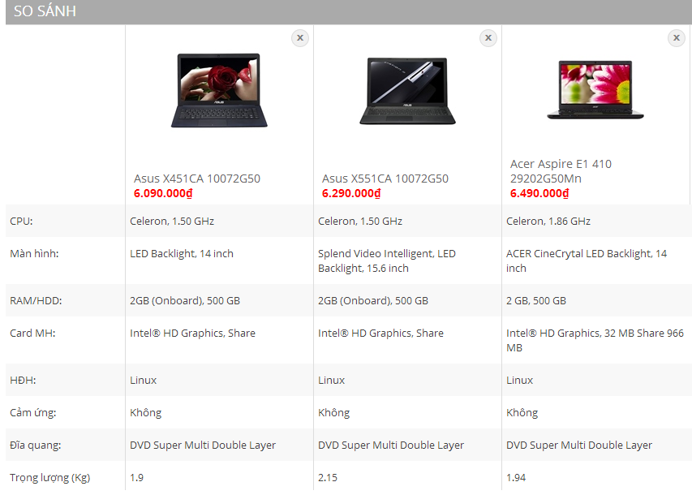

Scenario problem

Slide 7

Scenario problem

Slide 8






Scenario problem
Search
Add to compare
Detail
Detail
Make Decision
Make Decision
Calculate point from another compare hardware website

Slide 9
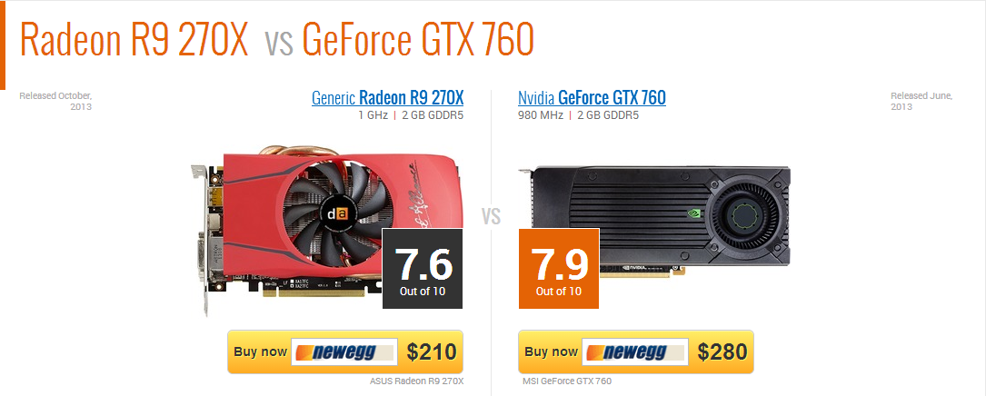
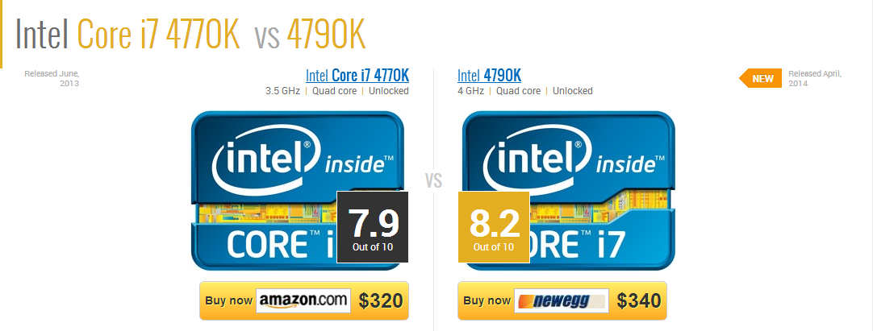
Scenario problem
http://gpuboss.com/gpus/Radeon-R9-270X-vs-GeForce-GTX-760
http://cpuboss.com/cpus/Intel-Core-i7-4790-vs-Intel-Core-i7-4770

Slide 10
Scenario problem
Text Blank all descriptions about laptop are always blanks.
1

Slide 11
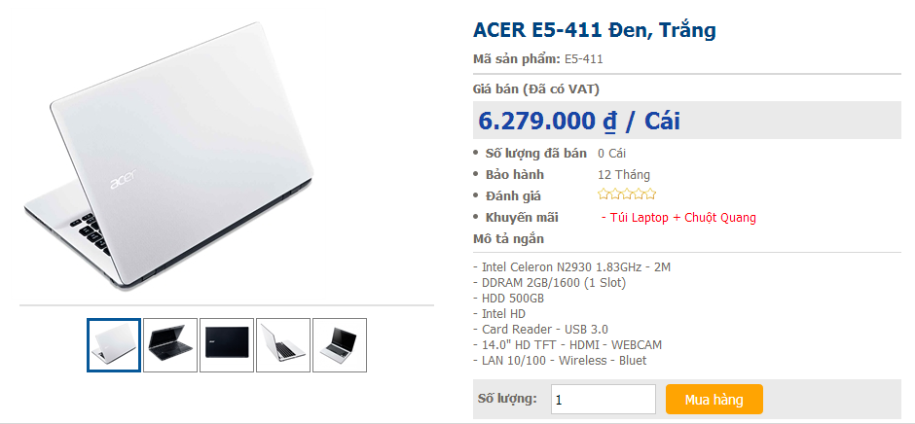
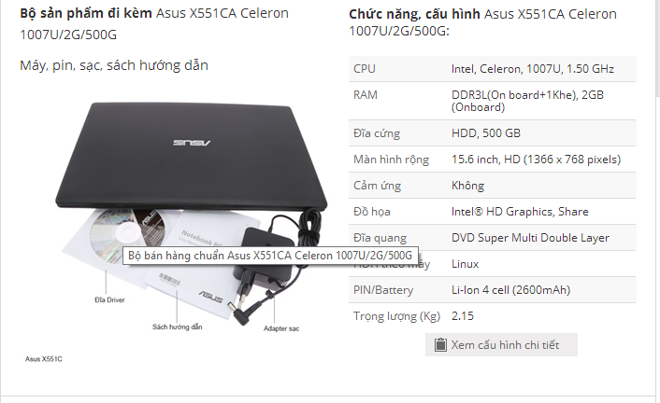
Scenario problem
Limitations We just can focus on 1 website at 1 time for comparing in that website.
2

Slide 12

Scenario problem
Rating system Do not have any rating laptop system in Vietnam.
3

Slide 13
Scenario problem
All of these Disadvantages will make customer to feel confuse when they want to buy laptop but don’t know which one is better than others.
1
2
3

Slide 14
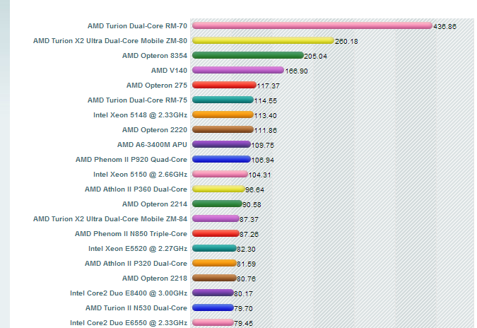



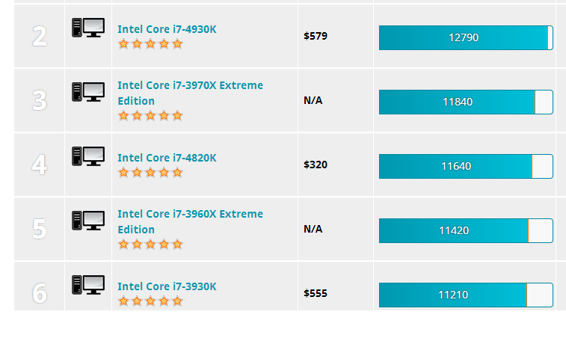
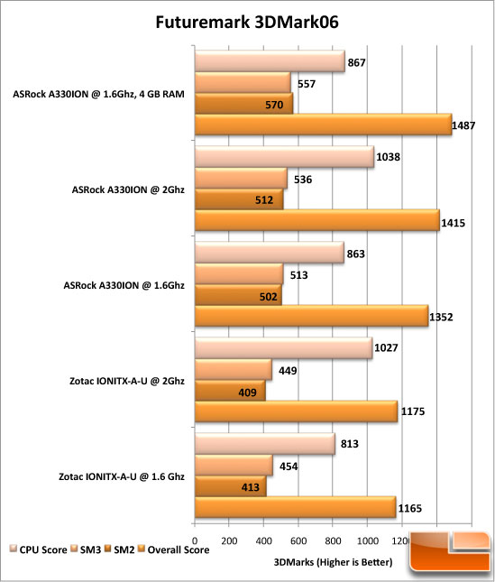

Our idea: collect data
Collect Data

Slide 15





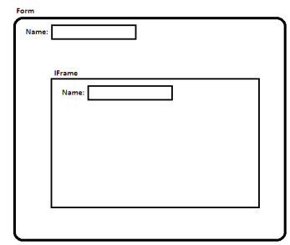
Our idea: collect data by parsing
Take link
Download
Remove Script
Load
Inspect
Display

Slide 16
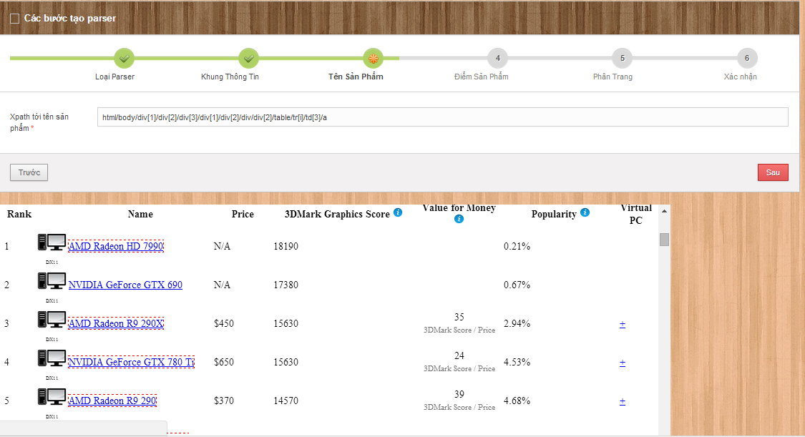
Our idea: collect data by parsing

Slide 17
Our idea: collect data by parsing
Step 1-From Clicked Node
Step 2-Get Parent “table” Node
Step 3-Get All Child Node
Step 4-Stop When Meet “HTML Node”Or Meet “ID”
Step 5-Take XPath
Step 6-Get Data

Slide 18
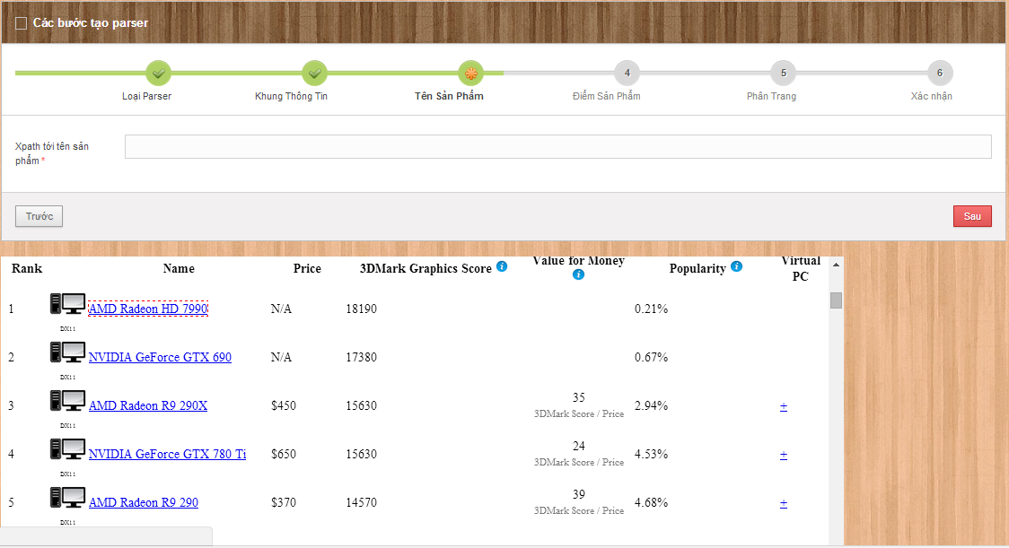
Step: 1&2 GET clicked node and get parent “TABLE” node
1-html/body/div[1]/div[2]/div[3]/div[1]/div[2]/div/div[2]/table/tr[1]/td[3]/a
2-html/body/div[1]/div[2]/div[3]/div[1]/div[2]/div/div[2]/table/tr[2]/td[3]/a
3-html/body/div[1]/div[2]/div[3]/div[1]/div[2]/div/div[2]/table/tr[3]/td[3]/a
4-html/body/div[1]/div[2]/div[3]/div[1]/div[2]/div/div[2]/table/tr[4]/td[3]/a
5-html/body/div[1]/div[2]/div[3]/div[1]/div[2]/div/div[2]/table/tr[5]/td[3]/a
html/body/div[1]/div[2]/div[3]/div[1]/div[2]/div/div[2]/table/tr[i]/td[3]/a

Slide 19

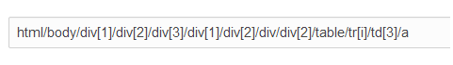
Step 3&4: GET all child node and stop when meet “HTML” NODE, meet “ID”

Slide 20
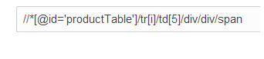
Step 5&6: Take Xpath and get data
AMD Radeon HD 7990: 18190
NVIDIA GeForce FTX 690: 17380
AMD Radeon R9-290x : 15630
NVIDIA GeForce GTX 780: 15630
AMD Radeon R9 290: 14570
Product Name Xpath
Product Point Xpath

Slide 21
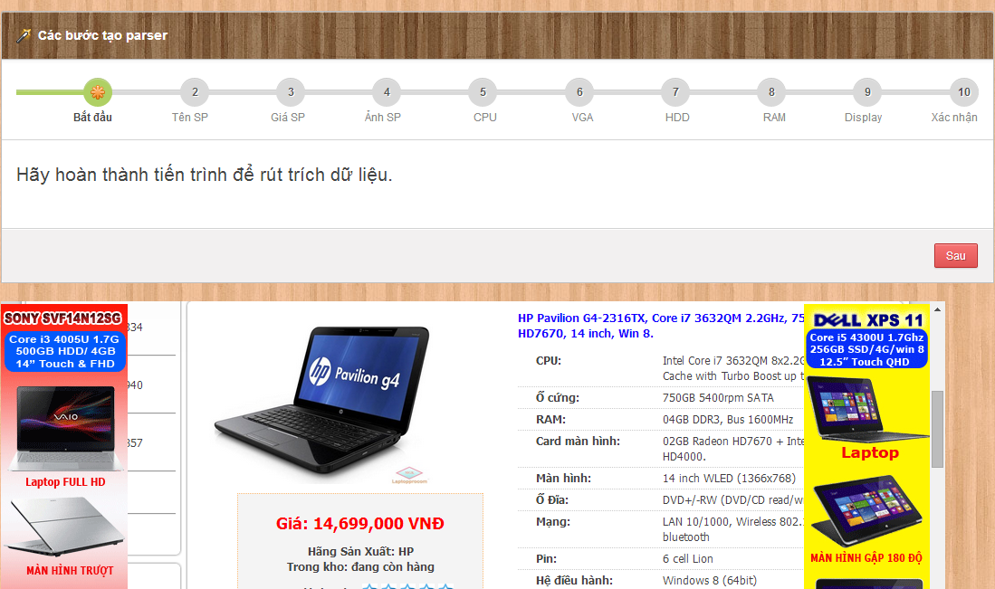
Our Ideas: Take laptop hardware's - Option 1

Slide 22
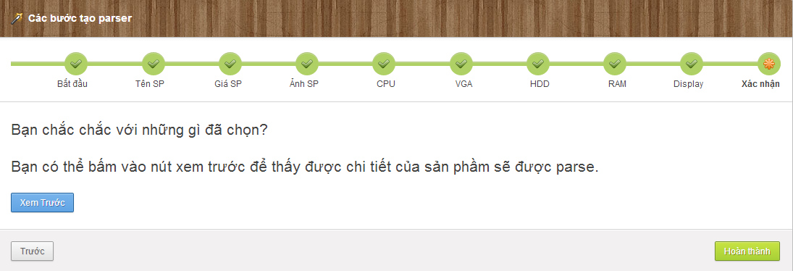
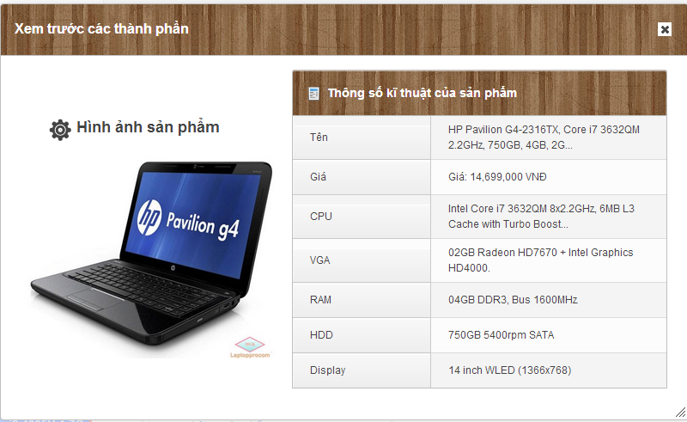
Our Ideas: Take laptop hardwares - Option 1
Name Xpath: //*[@id='pro_detail']/div/div/div[2]/div/div[1]/p
…
Display Xpath: //*[@id='pro_detail']/div/div/div[2]/div/div[5]/p

Slide 23
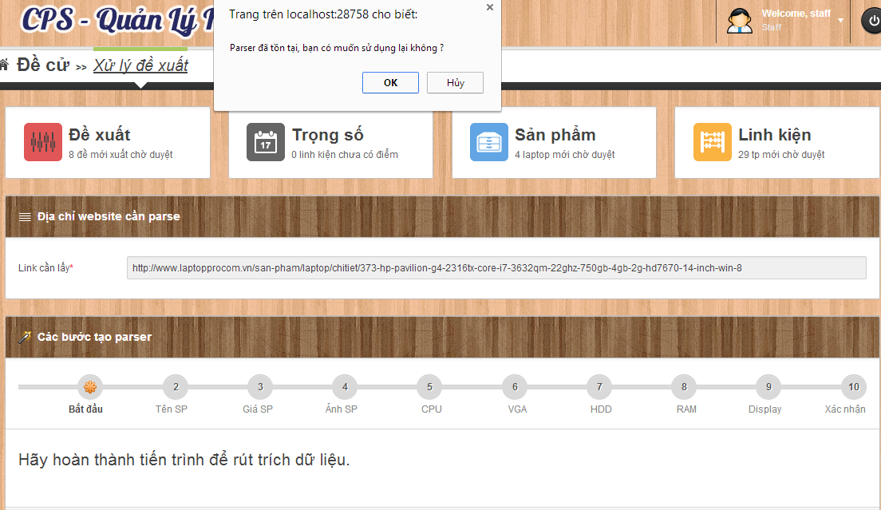
Our Ideas: Take laptop hardware's - Option 2
Auto Parse base on Existed parser
Return Option 1

Slide 24




Our idea: build data system
Build Data System

Slide 25





Our idea: build data system
New Laptop
Data Object
Database
Is New
False
True
Notes:
Hệ thống em insert 1 laptop mới và matching với 1 sản phẩm có sẵn trong database.

Slide 26

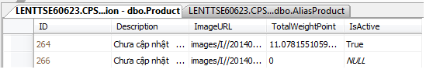
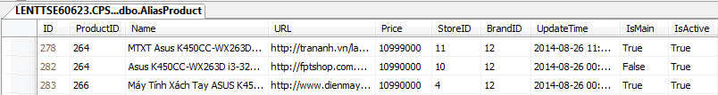
Our idea: build data system
Mapping
Data Object
New
MTXT Asus
K450CC-WX263D màu xám
Máy Tính Xách Tay ASUS
K450CC-WX263D (GRAY)
Notes:
264 có thêm 1 tên phụ.

Slide 27

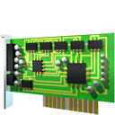






Our idea: build data system
Compare (80%<a<100%)
Compare (a =100%)
True
False
Join
True
False
Split
Mapping

Slide 28
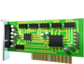
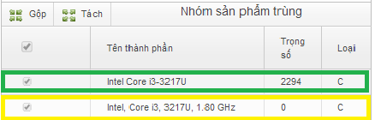
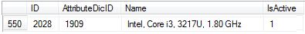
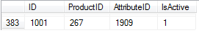
Our idea: build data system
Data Object
Compare
87%
Intel, Core i3, 3217U, 1.80 GHz
Intel Core i3-3217U 1.80 GHz
Intel Core i3-3217U
Laptop Id
Hardware in database
New hardware
Table: Dictionary
Table: ProductAttribute

Slide 29

Our idea: publish to user
Go Online

Slide 30


summary

Slide 31



Problem solution: example problem
Give 2 laptops, find out the best of them.
HP PAVILION 14 N237TU
ACER ASPIRE E1 470G

Slide 32
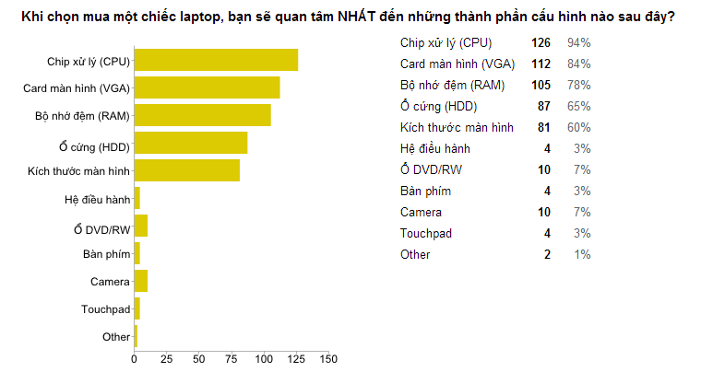
Problem solution
Determine 5 types of laptop’s hardware which are the most customer will be interested in when choosing a laptop.
http://bit.ly/cps-survey-summary

Slide 33

Problem solution
Chipset (CPU)
Graphic card (VGA)
Memory (RAM)
Hard disk (HDD)
Display
Price
Suggest for user
make decision
Score

Slide 34
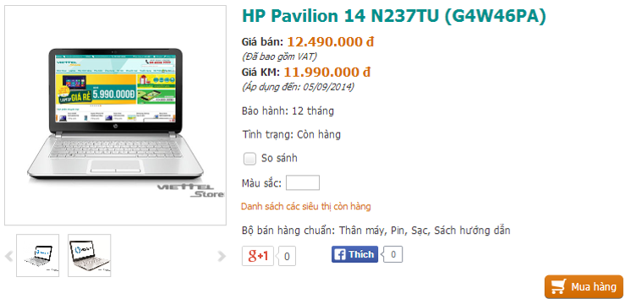
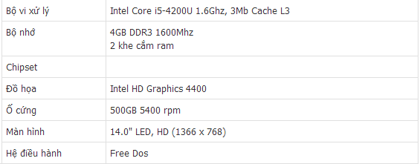


Problem solution: collect data
Laptops
viettelstore.vn
Notes:
Tách thành 2 slide

Slide 35
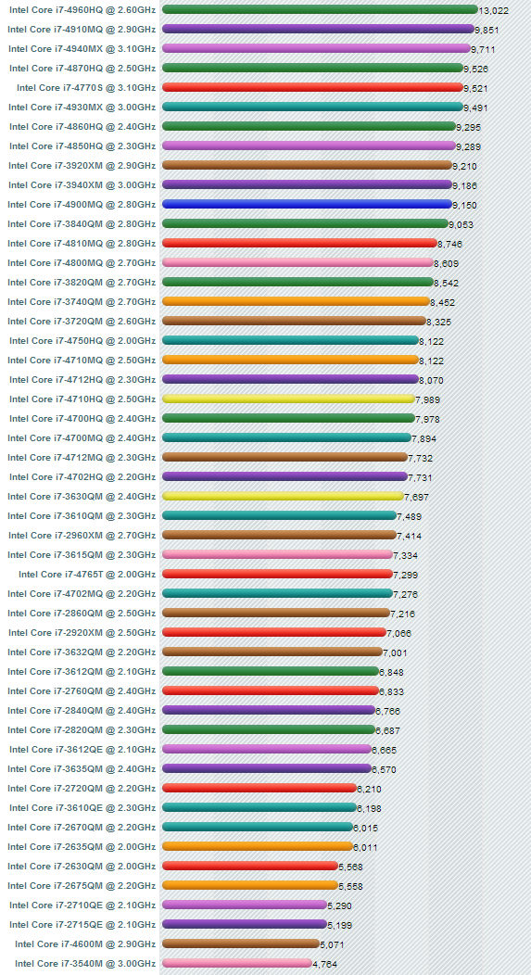
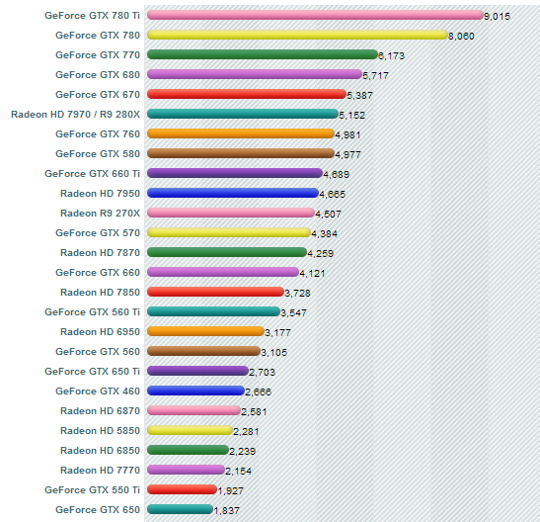

Problem solution: collect data
Laptop’s Hardwares
cpubenchmark.net
videocardbenchmark.net
Notes:
Tách thành 2 slide

Slide 36

Problem solution: collect data
Intel Core i5-4200U

Slide 37
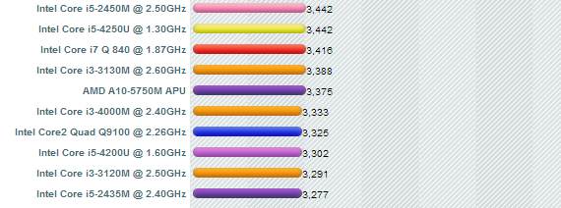
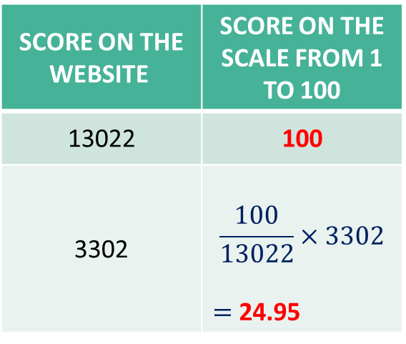
Problem solution: reduce score
Laptop’s Hardwares
13.022
Score on the website | Score on the scale from 1 to 100
13022 | 100
3302 | $$\frac{100}{13022}×3302$$ $=$ 24.95
Intel Core i5-4200U
3.302
Notes:
Tách thành 2 slide

Slide 38

Problem solution: reduce score
Hardware’s score
on the scale
from 1 to 100
 | HP PAVILION 14 N237TU | ACER ASPIRE E1 470G
Chipset (CPU) | 24.95 | 17.38
Graphic card (VGA) | 3.30 | 5.88
Memory (RAM) | 25 | 12.5
Hard disk (HDD) | 12.5 | 12.5
Display | 80.92 | 80.92

Slide 39
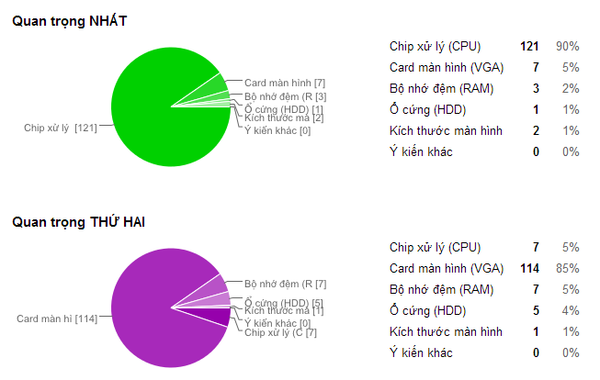
Problem solution: priority coefficient
http://bit.ly/cps-survey-summary

Slide 40
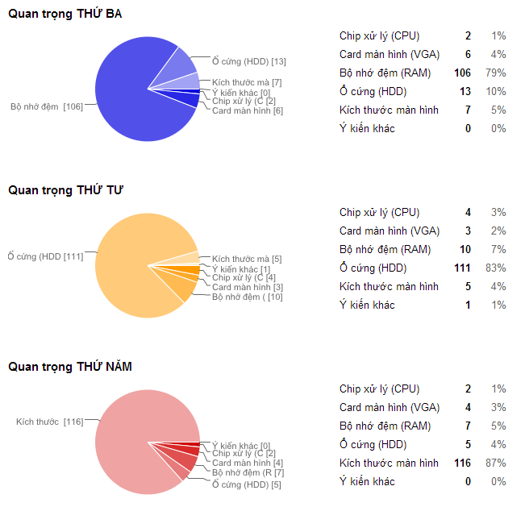
Problem solution: priority coefficient
http://bit.ly/cps-survey-summary

Slide 41
Problem solution: calculate product’s score
Hardware’s name | Score
Chipset (CPU) | c
Graphic card (VGA) | v
Memory (RAM) | r
Hard disk (HDD) | h
Display | d
☞

Slide 42
Problem solution: calculate product’s score
HP PAVILION 14 N237TU
ACER ASPIRE E1 470G

Slide 43
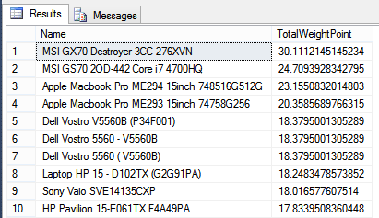
Problem solution: reduce score
Get highest product’s score in database
Get all product include product’s score and take the best product’s score.

Slide 44
Problem solution: reduce score
 | HP PAVILION 14 N237TU | ACER ASPIRE E1 470G
Product’s score | 12.86 | 11.26
Highest product’s score | 30.11 | 30.11

Slide 45
Problem solution: reduce score
➢ Reduce hardware’s score on the scale from 1 to 100
➢ Define:
P = Highest product’s score.
p =
Product’s score which will be reduced.
p’ = Product’s score on the scale from 1 to 100.
☞

Slide 46
Problem solution: reduce score
Product’s score
on the scale
from 1 to 100
 | HP PAVILION 14 N237TU | ACER ASPIRE E1 470G
Product’s score | 12.86 | 11.26
Highest score in the database | 30.11 | 30.11
Score on the scale from 1 to 100

Slide 47
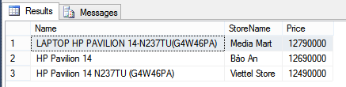
Problem solution: calculate price/score
Get all product’s price from stores of a product.
Get all product alias include store, product’s price.
Max Price
Min Price

Slide 48
Problem solution: calculate price/score
➢ Define:
P_{min/max} = Min/Max price of a product
S =
Product’s score
R_{min/max} = Min/Max price for each product’s score
☞

Slide 49
Problem solution: calculate price/score
 | HP PAVILION 14 N237TU | ACER ASPIRE E1 470G
Product’s min price (VNĐ) | 12.490.000 | 8.990.000
Product’s max price (VNĐ) | 12.790.000 | 8.990.000
Product’s score | 42.71 | 37.40
Min Price for each score (VNĐ)
Max Price for each score (VNĐ)
Price for each score

Slide 50

Problem solution: compare
Product’s score on the scale from 1 to 100
Min/Max price of each product’s score

Slide 51
Features
Search
Smart
Compare
Recommend
Product
Suggestion
Import Excel
Get data from web
Training System

Slide 52

demonstration

Slide 53



Story board
 | Guest
 | Member
 | Staff

Slide 54



Demo scenario: guest
Search product
Add to cart
View compare

Slide 55





Demo scenario: member
Search product by Price
View Compare
Search Not Found
View Details
Recommend

Slide 56

Demo scenario: staff
Train machine
Get data from web

Slide 57
Advantages AND Disadvantages
Advantages
Suggestion
Training System
Disadvantages
Staff spend time for training
Not support mobile version
Many Resources
Smart Compare
Not provide Payment Method
Staff must have knowledge about hardware

Slide 58


Future plan
Optimize algorithm
Build mobile application

Slide 59
Q&A

Slide 60
Thank You !

Slide 61
String Comparisons

Slide 62
Define Problem
Given 2 strings. Calculate their matching percent.
First String | Second String | Result (percent)
Healed | Sealed | 80
Healed | Healthy | 55
Healed | Heard | 44
Healed | Herded | 40
Healed | Help | 25
Healed | Sold | 0

Slide 63
Requirement
A robustness to changes of word order: two strings which contain the same words, but in a different order, should be recognised as being similar.
Language independence: the algorithm should work not only in English, but in many different languages.

Slide 64
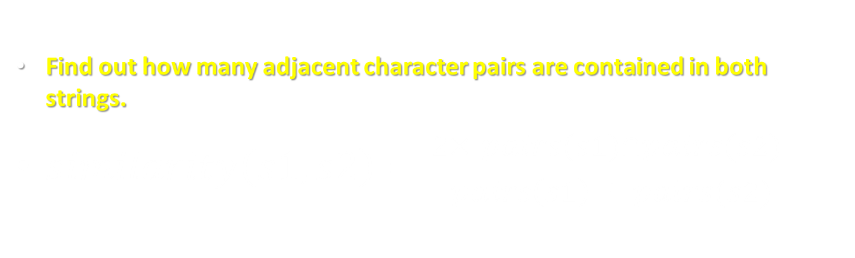
Solution
Find out how many adjacent character pairs are contained in both strings.
$similarity\left(s1,s2\right)=\frac{2×\left|pairs(s1)∩pairs(s2)\right|}{\left|pairs\left(s1\right)\right|+\left|pairs(s2)\right|}$

Slide 65
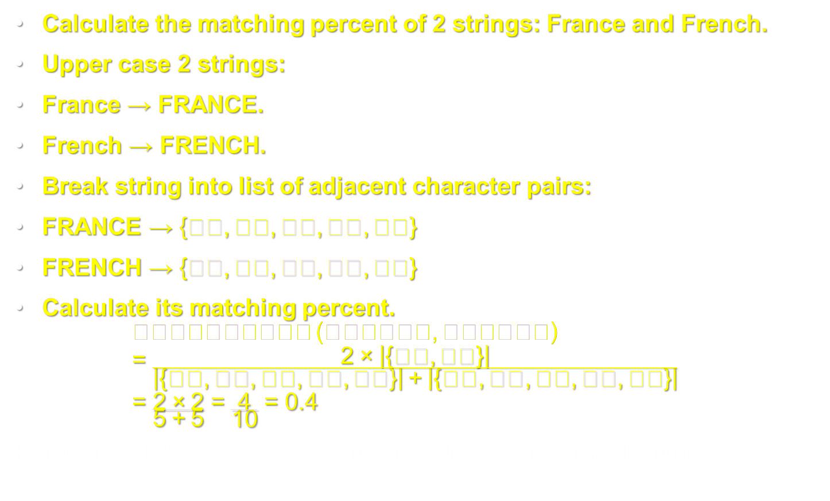
Example
Calculate the matching percent of 2 strings: France and French.
Upper case 2 strings:
France $→$ FRANCE.
French $→$ FRENCH.
Break string into list of adjacent character pairs:
FRANCE $→\left\{FR,RA,AN,NC,CE\right\}$
FRENCH $→\left\{FR,RE,EN,NC,CH\right\}$
Calculate its matching percent. $similarity\left(FRANCE,FRENCH\right)=\frac{2×\left|\left\{FR,NC\right\}\right|}{\left|\left\{FR,RA,AN,NC,CE\right\}\right|+\left|\left\{FR,RE,EN,NC,CH\right\}\right|}$ $=\frac{2×2}{5+5}=\frac{4}{10}=0.4$
Reference : http://www.catalysoft.com/articles/strikeamatch.html

